Slide 1
0. Introduction and basic concept of Python
SPEAKER: NI Shijun

Slide 2
Content
Introduction of Python and Installation of Anaconda
Basic concept of Python
Introduction of Python libraries

Slide 3
Introduction of Python and Installation of Anaconda

Slide 4
What is Python?
Python is a programming language created in 1991 by Guido van Rossum
It can be used for:
Web/ Software Development
Mathematics
Statistical analysis
System scripting
Big Data analysis
Machine Learning
…

Slide 5
Why Python?
Works on different platforms(Windows, Mac, Linux, Raspberry Pi, …)
Has a simple syntax similar to the English language.
Has syntax that allows developers to write programs with fewer lines than some other programming languages.
A good language for beginners
Life is short, you need Python!

Slide 6
Differences between Python and R
They are both open-source languages
Python is a general purpose programming language.
Created by Guido Van Rossum in 1991
Best for readability and a good language for beginners.
Not only researchers but also programmers use python
R is a statistical oriented programming language.
Created by Ross Ihaka and Robert Gentleman in 1995
A steep learning curve
Long used in academics and research

Slide 7
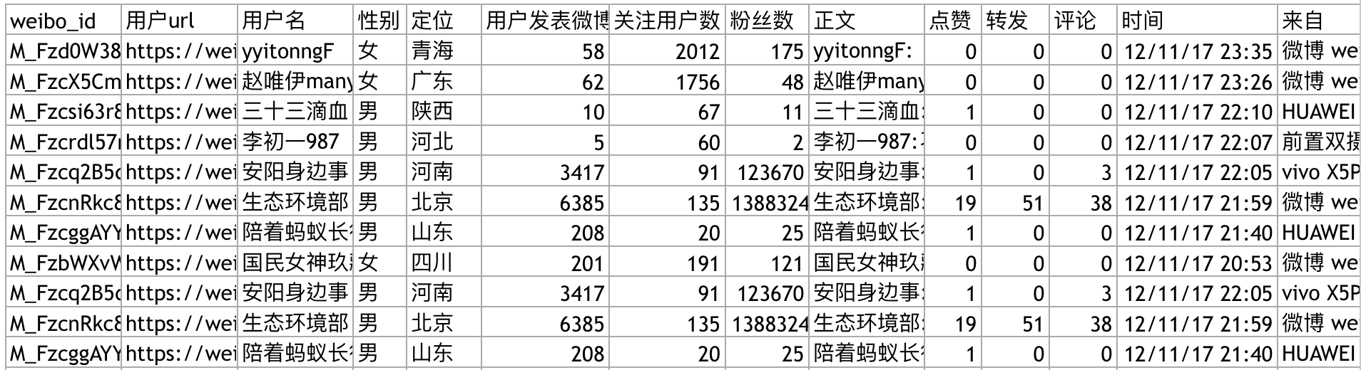
In this course, Python can be used for:
Retrieve data from social media websites such as Sina Weibo

Slide 8
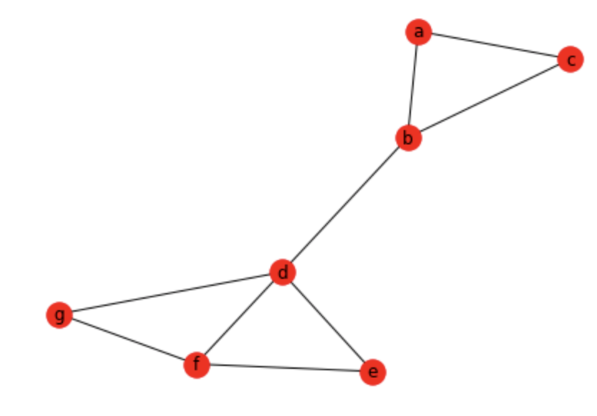
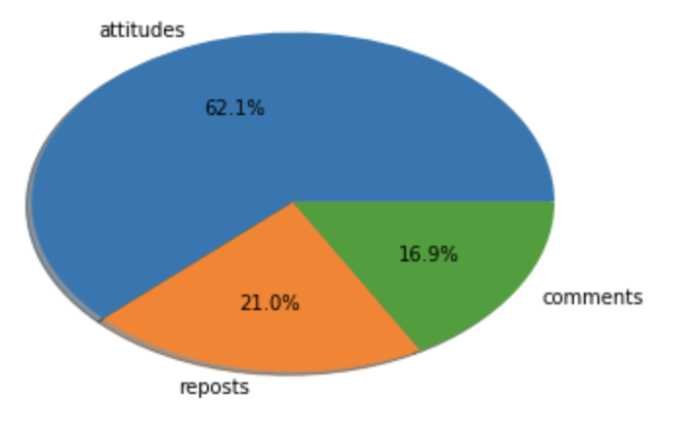
In this course, Python can be used for:
Data Visualization

Slide 9
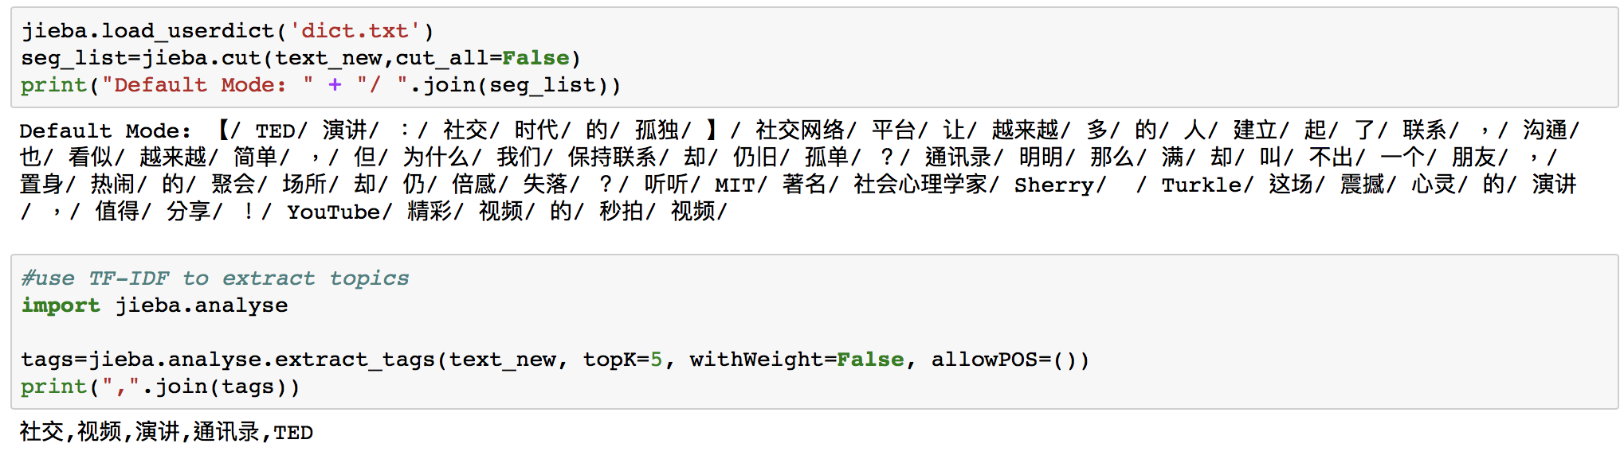
In this course, Python can be used for:
Text analysis --- topic of the text
Fewer codes, more advanced functions

Slide 10
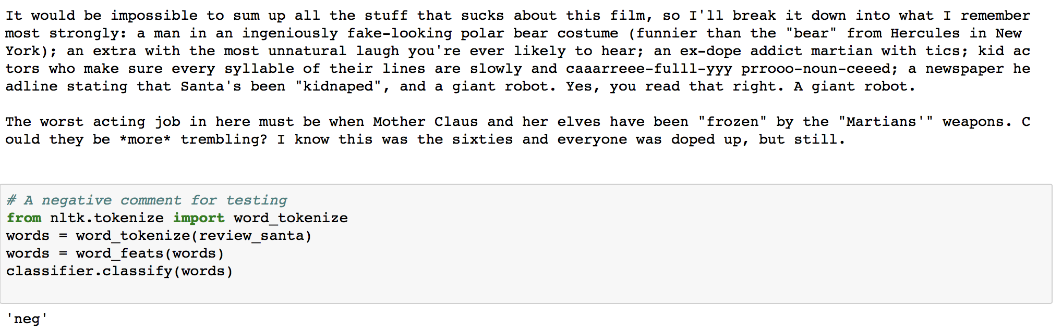
In this course, Python can be used for:
Classification and Prediction --- positive or negative movie comments?

Slide 11
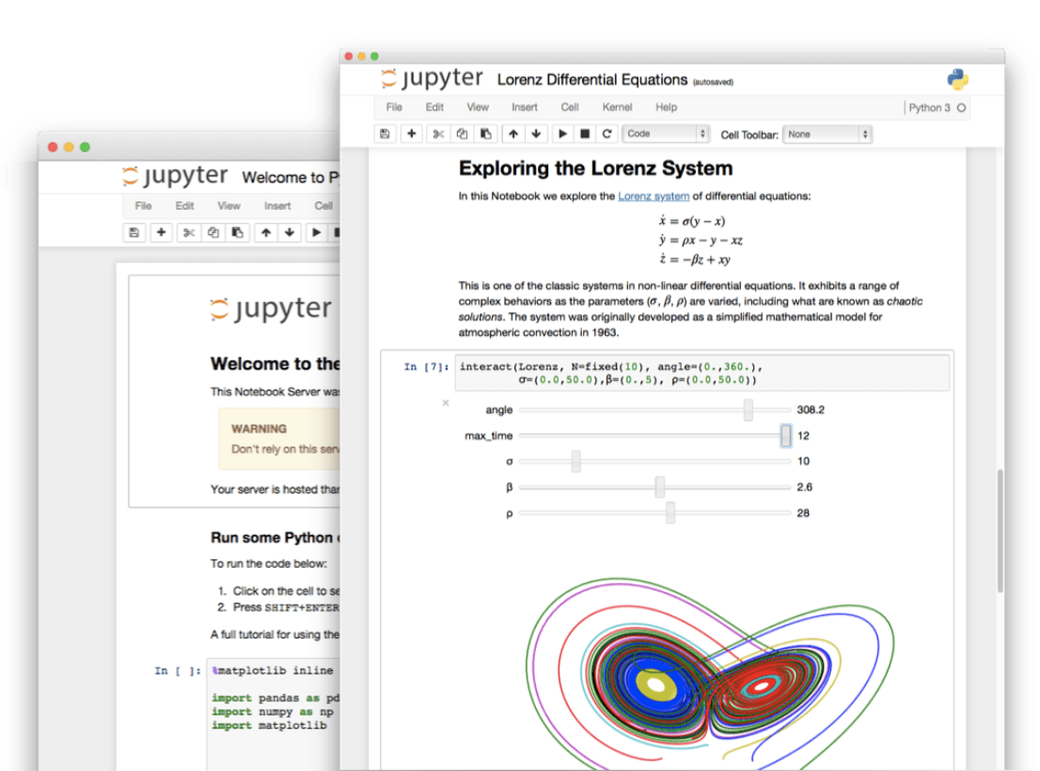
Jupyter Notebook
The Jupyter Notebook is an open-source web application that allows you to create and share documents that contain live code, equations, visualizations and narrative text
data cleaning and transformation
numerical simulation
statistical modeling
data visualization
machine learning
…

Slide 12
Install Jupyter Notebook
The Jupyter.org strongly recommend installing Python and Jupyter using the Anaconda Distribution
Includes Python, Jupyter Notebook, and other commonly used third party packages for scientific computing and data science.

Slide 13
Install Jupyter Notebook
First, download Anaconda. --- choose Python 3 version
Why not Python 2? Many libraries such as pandas will no longer support Python 2
https://www.anaconda.com/download/

Slide 14
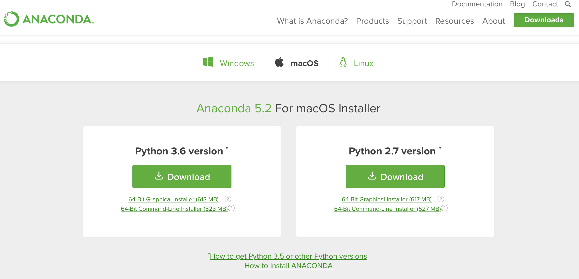

Slide 15
install Jupyter Notebook
Second, install the version of Anaconda which you downloaded, following the instructions on the download page.
Congratulations, you have installed Jupyter Notebook!
To run the notebook,
Just double click the Anaconda navigator icon, find jupyter notebook and click “launch”
or run the following command at the Terminal (Mac/Linux) or Command Prompt (Windows):
jupyter notebook

Slide 16
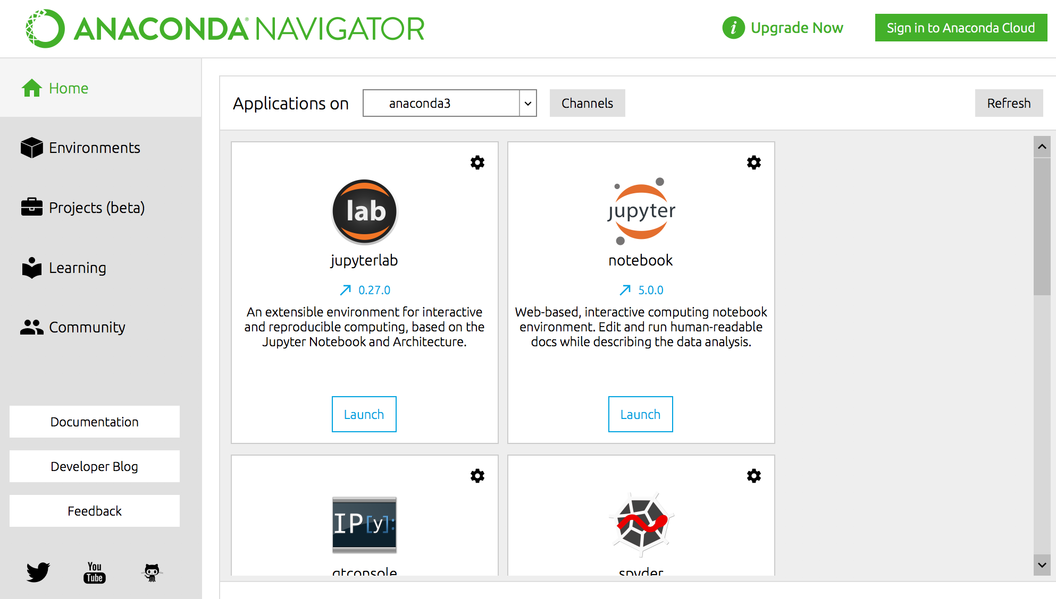

Slide 17
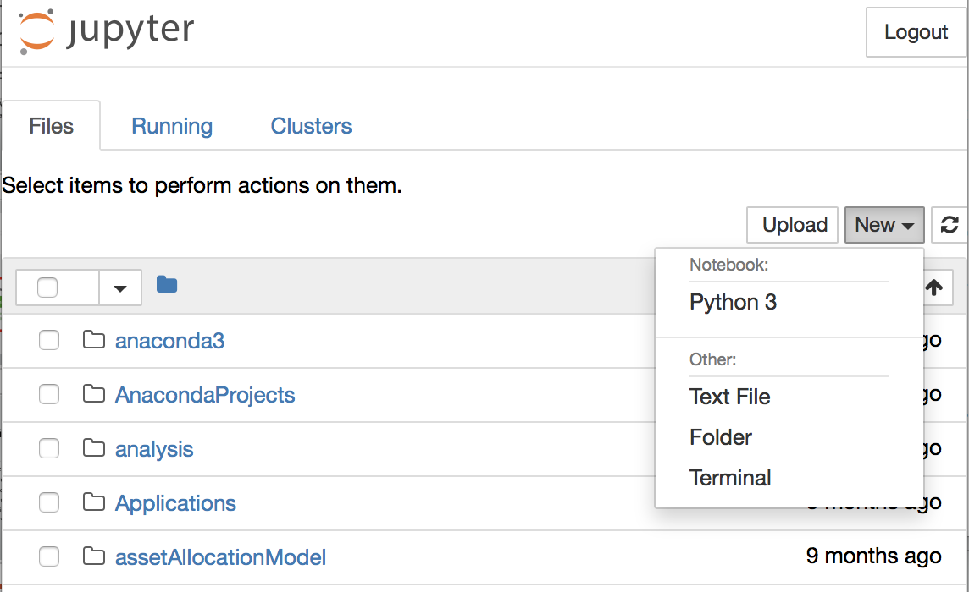
You can create a new file for coding, or just open a existing notebook file
In this course, I will provide codes for each lecture

Slide 18
Basic concept of Python

Slide 19
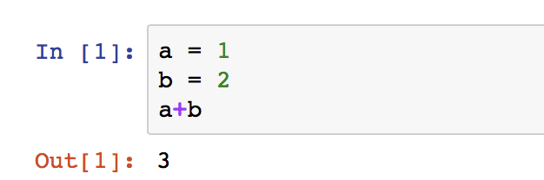
Variables
Unlike other language such as Java, Python has no command for declaring a variable.
A variable is created the moment you first assign a value to it.

Slide 20

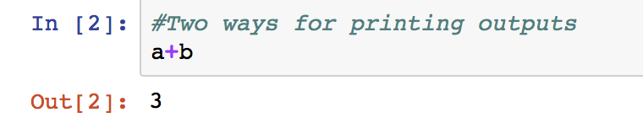
Variables
In Jupyter, there are two ways to print outputs
print(variables)
Just type in variables

Slide 21
Rules for naming variables
A variable name must start with a letter(a-z, A-Z) or the underscore character(_)
A variable name cannot start with a number
A variable name can only contain alpha-numeric characters and underscores (a-z, A-Z, 0-9, and _ )
Variable names are case-sensitive (age, Age and AGE are three different variables)

Slide 22
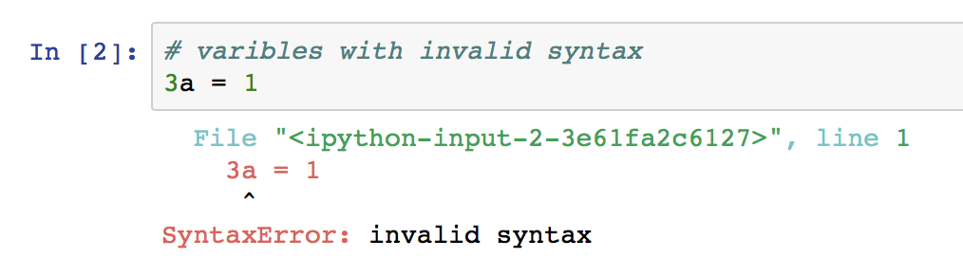
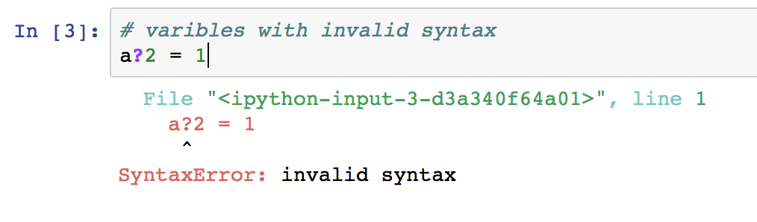
Codes about naming rules
# means Commented-Out Code

Slide 23
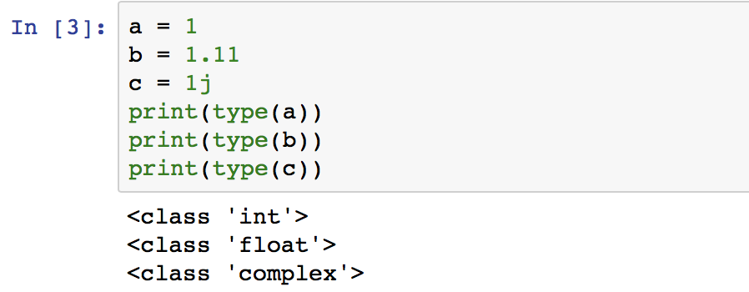
Numbers
There are 3 types of numbers
Int (Integer): no decimals
Float: has decimals
Complex
We can use type() function to verify the type of object in Python

Slide 24
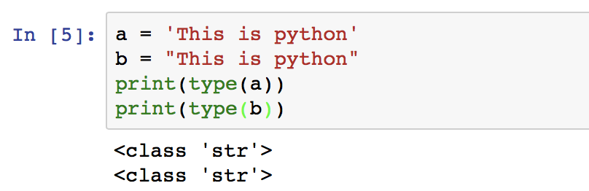
Strings
String literals in python are surrounded by either single quotation marks( ’string‘ ), or double quotation marks( “string” ).
Some useful methods:
string1 + string2: string concatenation
strip() : remove whitespace from beginning or end of the string
len() : return length of the string
lower() / upper() : return the string in lower / upper case
replace() : replace a string to another new string
split() : split a string to several sub-strings

Slide 25
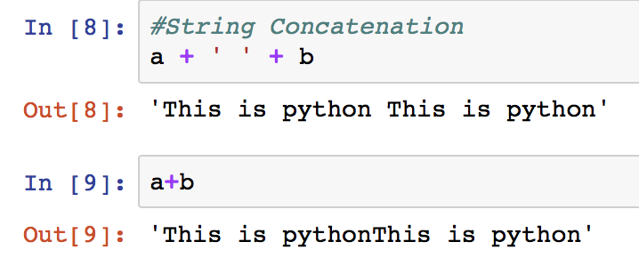
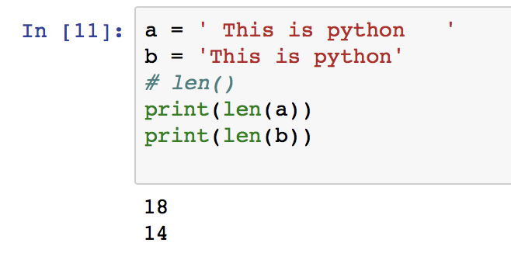
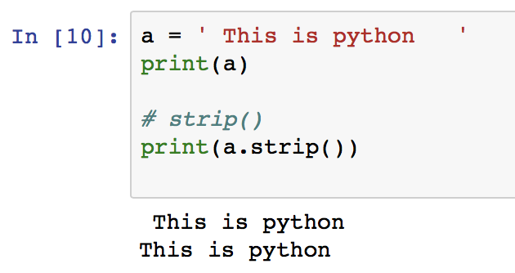
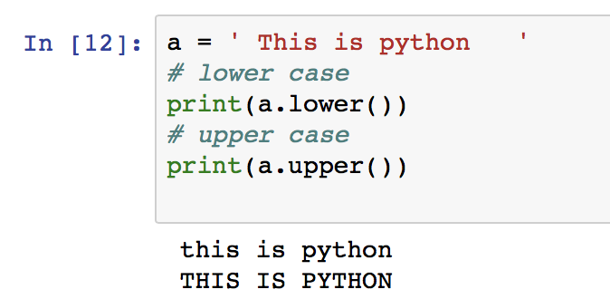
Strings

Slide 26
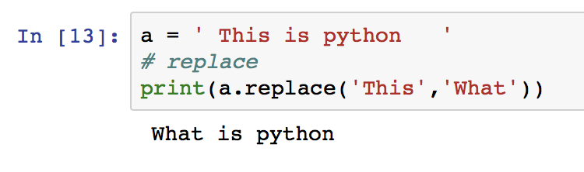
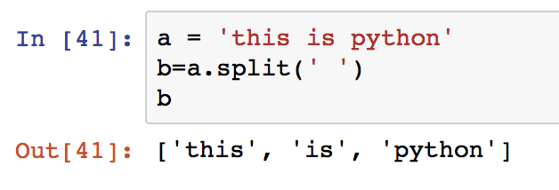
Strings

Slide 27
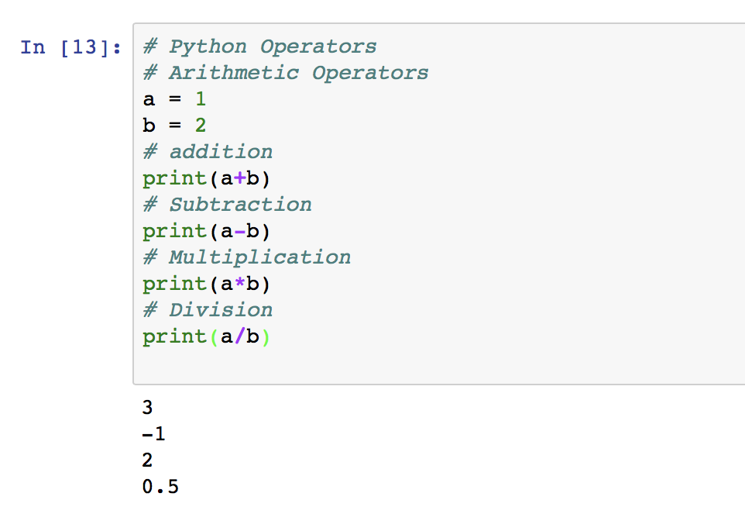
Operators
Operators are used to perform operations on variables and values.
Arithmetic Operators
Addition: x + y
Subtraction: x – y
Multiplication: x * y
Division: x / y
…

Slide 28
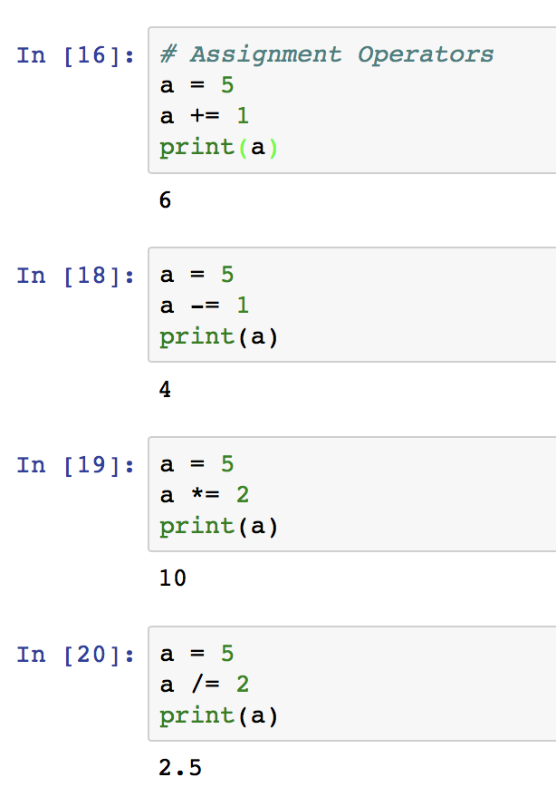
Operators
Assignment Operators
= : x = 5
+= : x += 1 ➔ x = x + 1
-= : x -= 1 ➔ x = x – 1
*= : x *= 1 ➔ x = x * 1
/= : x /= 1 ➔ x = x / 1

Slide 29
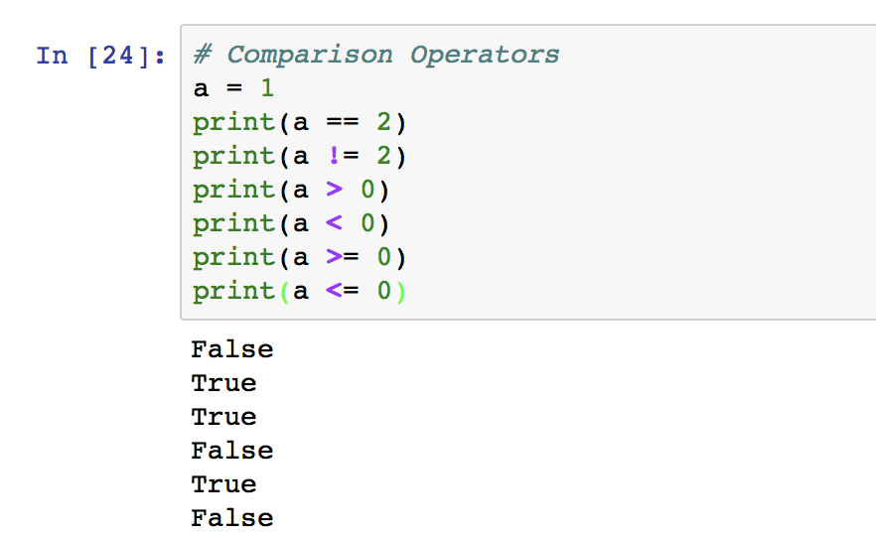
Operators
Comparison Operators: used to compare two values
Equal: ==
Not equal: !=
Greater than: >
Less than: <
Greater than or equal to: >=
Less than or equal to: <=

Slide 30
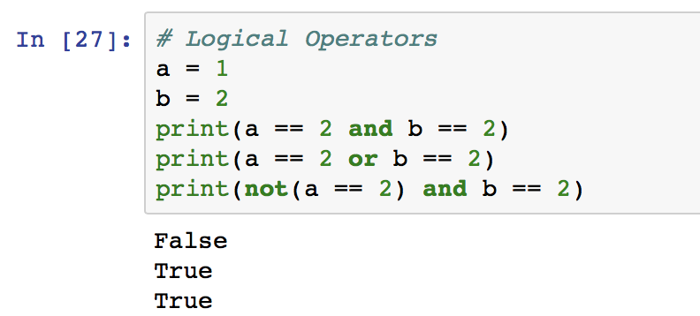
Operators
Logical Operators
And: Returns True if both statements are true
Or: Returns True if one of the statements is true
Not: Reverse the result, returns False if the result is true

Slide 31
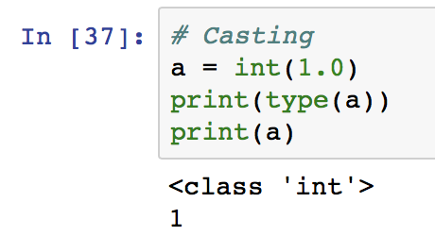
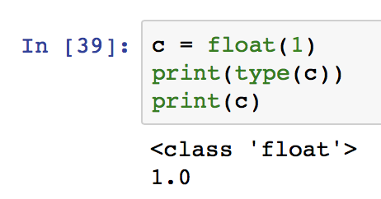
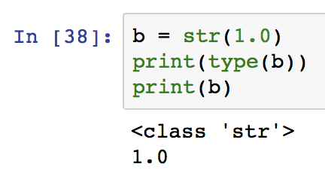
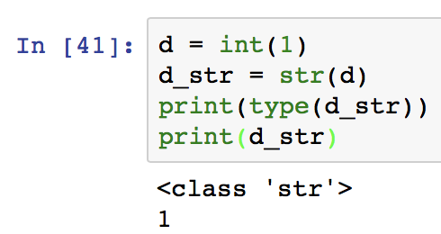
Casting---Specify a Variable Type
If we type in codes like this: a = 1. ➔ the type of a is integer
How if we want “a” is string type? ➔ a = str(1) then ”a” will be “1”
int()
float()
str()

Slide 32
Four useful data types
List: Ordered and changeable. Allows duplicate members.
Tuple: Ordered and unchangeable. Allows duplicate members.
Set: Unordered and unindexed. No duplicate members.
Dictionaries: Unordered, changeable and indexed. No duplicate members.

Slide 33
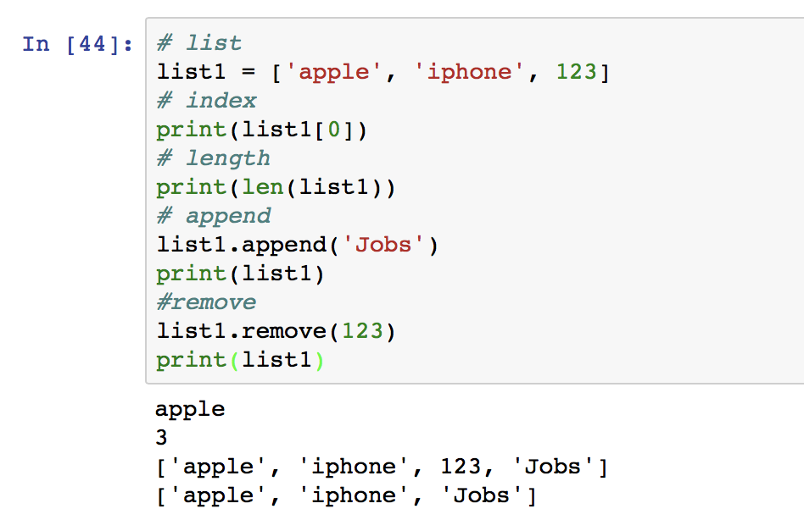
Four useful data types: list
List: list0 = [1, 2, 3, 4, 5]. list1=[‘a’, ‘b’, ‘c’, ‘d’].
lists are written with square brackets
Each item has a index in list, start with 0,1,2… such as list0[1] list1[0]
append() : append a new item to list
remove() : remove an item from list
len() : return number of items in a list

Slide 34
Four useful data types: tuple
tuples are written with round brackets.
You can not change items in a tuple
Tuple1 = (“apple”, ”iphone”, ”jobs”)
Len() and index methods can be used in a tuple

Slide 35
Four useful data types: set
sets are written with curly brackets
Unordered, so items will show in a random order---can not use index
Set1 = {‘apple’, ‘iphone’, ‘jobs’} or set2 = set((‘apple’, ‘iphone’, ‘jobs’))
Use add() to add a item into a set(not append()!)
len(), remove() can be used in a set

Slide 36
Four useful data types: dictionary
In Python dictionaries are written with curly brackets, and they have index keys and values, each pair of key and value is separated by a comma”,”
dict1 = { “apple”: “icon”,
”iphone”: “8plus”,
”ipad”: “pro”}
Change item values: dict1[“apple”] = “compang”
Add a new item: use new index keys and assign a value to it: dict[“new”:”iphoneX”]
Remove an item: del() (not remove()!): del(dict1[“apple”])
In a dictionary, value can nest other data types, such as list, dict,…

Slide 37
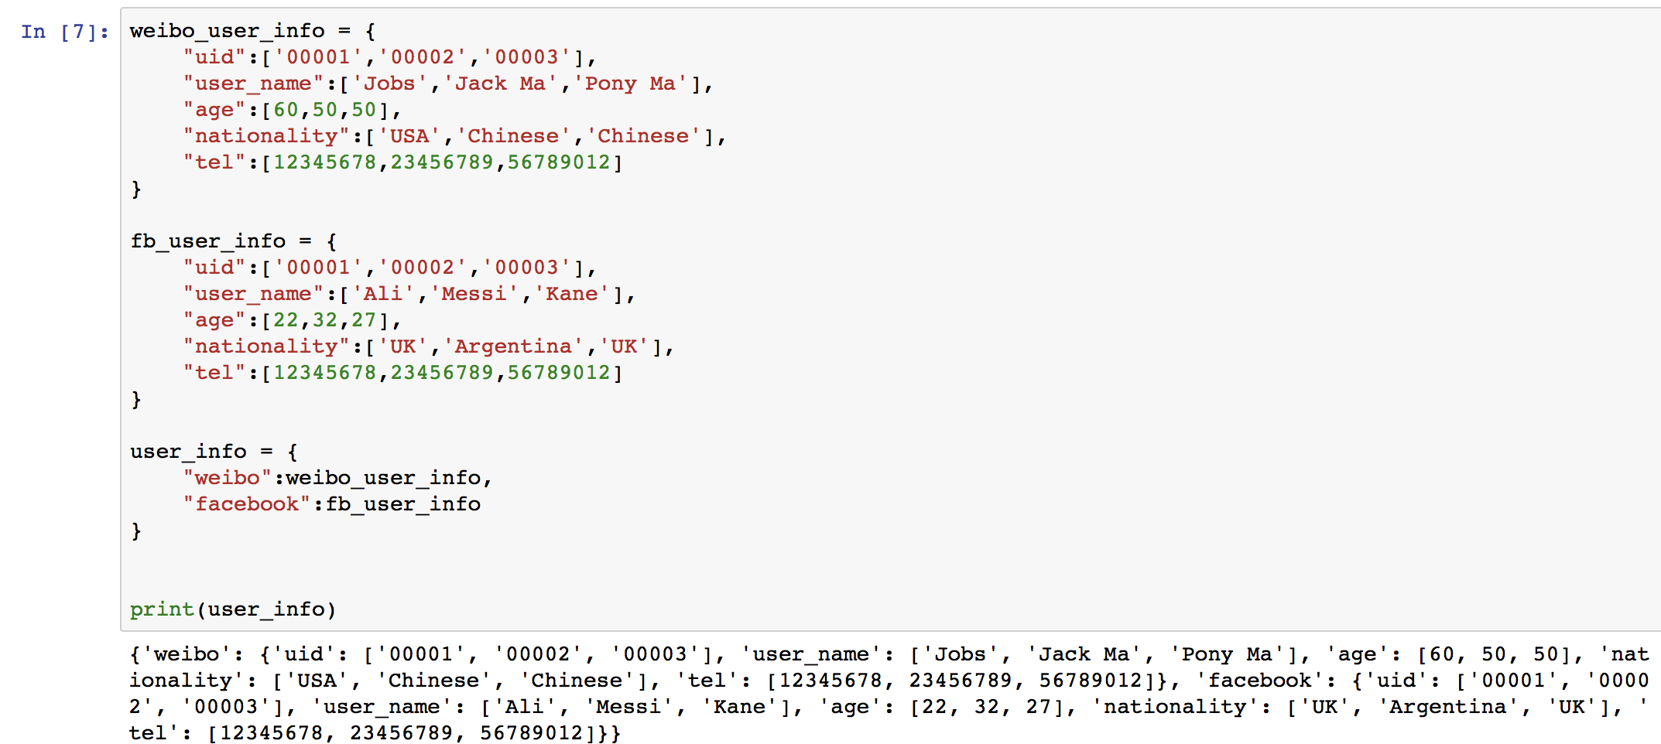
Four useful data types: dictionary

Slide 38
Conditions
We have learned Operators, then we can use these in Python Conditions
The keywords: if…elif…else
Python relies on indentation, using whitespace, to define scope in the code. Each condition statements on new lines MUST use indentation

Slide 39
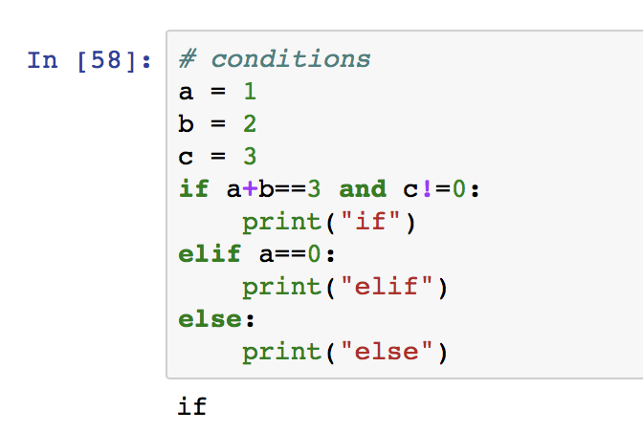
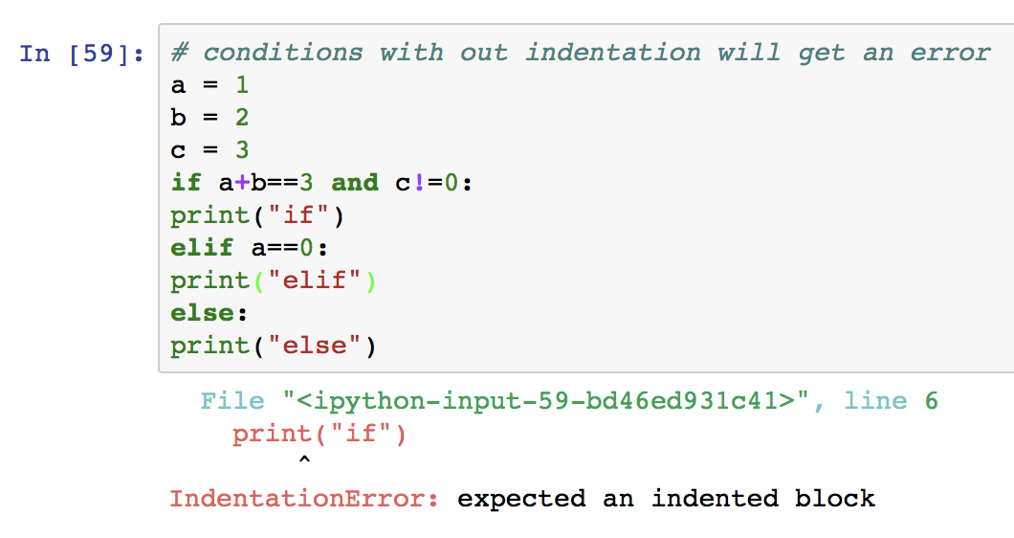

Slide 40
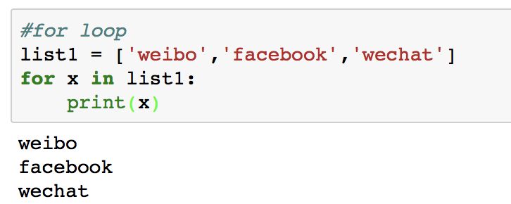
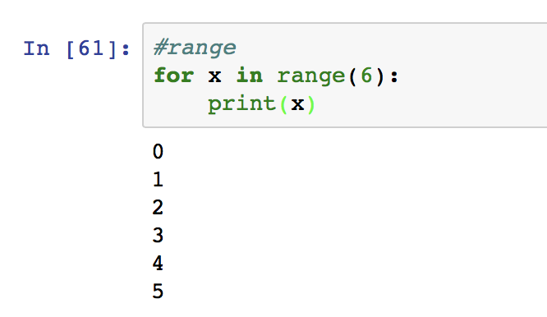
For Loops
A for loop is used for iterating over a sequence (that is either a list, a tuple or a string).
With the for loop we can execute a set of statements, once for each item in a list, tuple, set etc.
range() function is ofen used in for loops
range(3) ==> 3 values from 0 to 2, 0,1,2. 3 is not included!

Slide 41
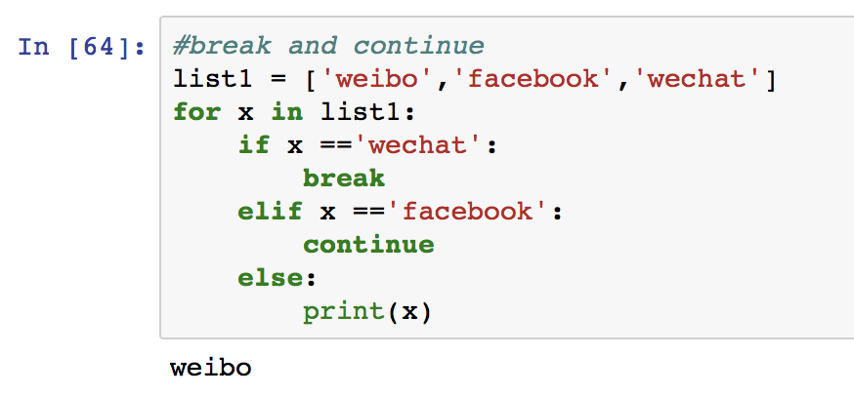
For Loops: break and continue
we can use break to stop loops before all the items has been looped through
We can use continue to stop current iteration loop and jump to next loop

Slide 42
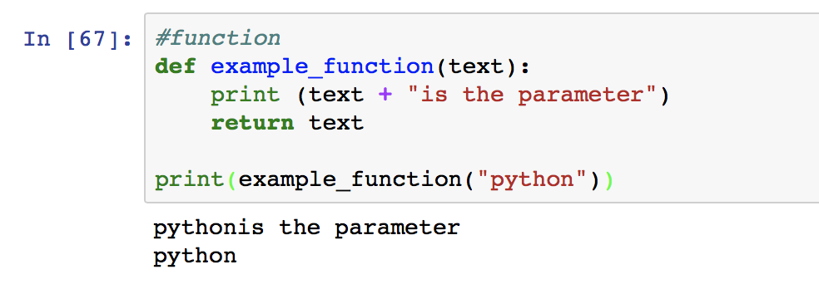
Functions
A function is a block of code which only runs when it is called.
You can pass data, known as parameters, into a function, and return data as a result.
Use def keyword to define a function
Use the function name followed by parenthesis to call the function

Slide 43
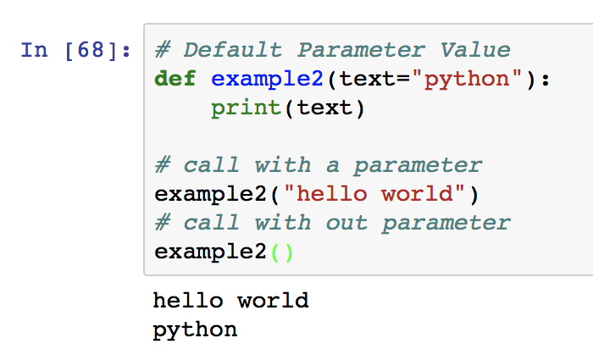
Functions: Default Parameter Value
We can use default parameter value when defining a function
If we call the function without parameter, the function will use default parameter value

Slide 44
In-class Exercise
Try to write a function “f1”,
Including two parameters:
“li” for passing a list to ”f1”
“le” for passing a number to “f1”
For each item in the list “li”,
if the item is None or ‘’, please print a warning: “the item is None or ‘’!”
if the number of words in the item is greater than “le, please print the item in uppercase;
if the number of words in the item is less than or equal to ”le”, please print the item in lowercase;

Slide 45
In-class Exercise

Slide 46
File handling
In this course, we may read/write data into files, Python can help us
Read files
Use open() to get a file object, then use read() to get the content of the file
Write files
Use open() and an additional parameter to open a file, then use write() to write
”a”-append- add new content to the end of the file; If file does not exist, it will create a new file first
“w”-write- overwrite any existing content! If file does not exist, it will create a new file first

Slide 47
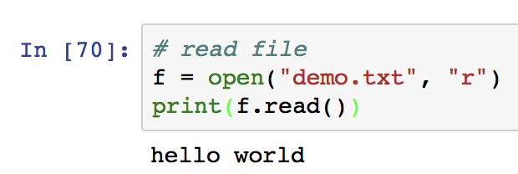
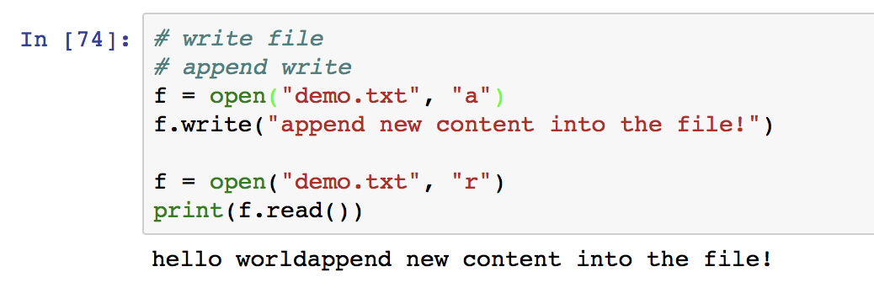
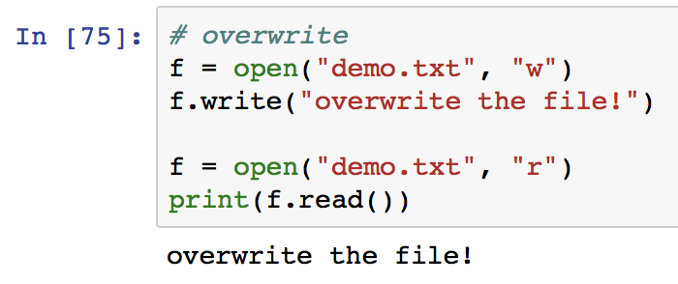

Slide 48
Introduction of Python libraries

Slide 49
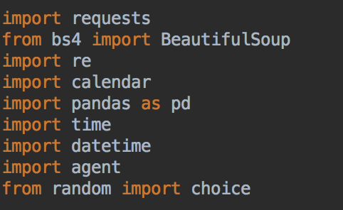
Python Libraries
Python library is a collection of functions and methods that allows you to perform lots of actions without writing your own code.
The Python Standard Library --- we can import them without downloading as long as we installed python
Other third-party library --- we should download them first, then import them into our codes. If we use anaconda, a lot of libraries has already downloaded while installing!
We can use “import” to import libraries into our codes, then call functions from libraries directly.

Slide 50
Python Libraries
There are several ways to import libraries
Example:
library A has a class B, and class B has a function C
import A --- we imported the whole library directly
if we want to call function C --- A.B.C
import A as a --- we import A and give it a short name a
if we want to call function C --- a.B.C
from A import B --- we just import class B from library A
if we want to call function C --- B.C

Slide 51
Useful libraries will be used in this course
NLTK --- Natural Language Toolkit
Numpy --- Fundamental package for scientific computing with Python
Pandas --- Python Data Analysis Library
scikit-learn --- Machine Learning in Python
Jieba --- Python Chinese word segmentation module
…
We will learn how to use these libraries in the rest of this course

